Slide 1
SJSU CS 46A Introduction to Programming
When you come in
Open Canvas
Download Lesson07_student.zip
Unzip it
Join our class on iClicker after started

Slide 2
SJSU CS 46A Introduction to Programming
4.1 Numbers
4.2 Arithmetic
4.3.1 Reading Input
Notes:
Sections 2.5 – 2.8

Slide 3
Java Class Scanner
In package java.util
Must import the class before using it
Java Class Libraries
Some useful methods
public int nextInt()
public double nextDouble()
public String next()
public String nextLine()
Notes:
No need to look at Java Class Libraries

Slide 4
Creating a Scanner Object
import java.util.Scanner;
/**
* Examples to use class Scanner to read input
* from the keyboard.
*
* @author Qi Yang
* @version 2022-09-15
*/
public class OverFlow
{
public static void main(String[] args)
{
// System.in: the keyboard
Scanner in = new Scanner(System.in);
}
}

Slide 5
Reading Integers From the Keyboard
public static void main(String[] args)
{
// Create a Scanner object
Scanner in = new Scanner(System.in);
// Read an integer and store it in
// an int variable
int intNum = in.nextInt();
. . .
}

Slide 6
Calculating and Displaying the Square
public static void main(String[] args)
{
Scanner in = new Scanner(System.in);
int intNum = in.nextInt();
// Calculate the square of intNum and store it in
// an int variable square
int square = intNum * intNum;
// Display the square of intNum
System.out.println("The square of " + intNum +
" is " + square + ".");
}

Slide 7
Lesson07_Examples
Class InputUsingScanner

Slide 8
Better to Have an Input Prompt
public static void main(String[] args)
{
// Create a Scanner object to get input from
// the keyboard
Scanner in = new Scanner(System.in);
// Display an input prompt
System.out.print("Enter an integer: ");
// Read an integer and store it in
// an int variable intNum
int intNum = in.nextInt();
. . .
}

Slide 9
iClicker Question #1
int intNum = in.nextInt();
int square = intNum * intNum;
System.out.println("The square of " + intNum +
" is " + square + ".");
The output is ________ when the input number is 1000000.
The square of 1000000 is 1000000000000.
The square of 1000000 is -727379968.
None of the above
Notes:
Million
Trillion
Using BlueJ Debugger

Slide 10
Overflow!
int intNum = in.nextInt();
int square = intNum * intNum;
System.out.println("The square of " + intNum +
" is " + square + ".");
The output is ________ when the input number is 1000000.
The square of 1000000 is 1000000000000.
The square of 1000000 is -727379968.
None of the above
Notes:
Million
Trillion
Using BlueJ Debugger

Slide 11
Primitive Data Types
Type | Description | size
int | -2,147,483,648 . . . 2,147,483,647 | 4 bytes
byte | -128 . . . 127 | 1 byte
short | -32,768 . . . 32,767 | 2 bytes
long | -9,223,372T . . . 9,223,372T | 8 bytes
double | A range of ±10³⁰⁸ and about 15 significant decimal digits | 8 bytes
float | A range of ±10³⁸ and about 7 significant decimal digits | 4 bytes
char | Unicode (extension of ASCII code) | 2 bytes
boolean | Two possible values: true or false (not string) | 1 bit
Notes:
Not classes, starting with lower case

Slide 12
Data Type long
long intNum = in.nextInt();
long square = intNum * intNum;
System.out.println("The square of " + intNum +
" is " + square + ".");
The square of 1000000 is 1000000000000.
Overflow when using int.
Notes:
Million
Trillion
The output is one trillion when the input number is one million.
Int intNum = in.nextInt(); will not work: Both must be long!
Could call method nextLong()

Slide 13
int intNum = in.nextInt();
System.out.print("Enter an integer: ");
DO NOT display input prompt
AFTER
reading the input!

Slide 14
System.out.println("Enter an integer: ");
int intNum = in.nextInt();
DO NOT use println() for input prompt!
Use print() to stay on the same line.

Slide 15
Arithmetic Operators
// Display an input prompt to get three integers
System.out.print("Enter three integers: ");
// Read three integers and store them in
// three int variables num1, num2, and num3
// 12 3 4
int num1 = in.nextInt();
int num2 = in.nextInt();
int num3 = in.nextInt();
int result = num1 / num2 * num3;
// Display the result
System.out.println("The result is " + result + ".");

Slide 16
iClicker Question #2
int result = num1 / num2 * num3;
System.out.println("The result is " + result + ".");
The output is ________ when the input numbers are 12, 3 and 4.
The result is 1.
The result is 16.
None of the above

Slide 17
Operators * and /
int result = num1 / num2 * num3;
System.out.println("The result is " + result + ".");
The output is ________ when the input numbers are 12, 3 and 4.
The result is 1.
The result is 16.
None of the above

Slide 18
Lesson07_Examples
Class OperatorPrecedence

Slide 19
Using () to Change the Order
int result = num1 / (num2 * num3);
System.out.println("The result is " + result + ".");
The output is ________ when the input numbers are 12, 3 and 4.
The result is 1.
The result is 16.
None of the above

Slide 20
Operator Precedence
Same as in Math
Low: +, - (from left to right)
High: *, / (from left to right)
Highest: ()

Slide 21
Integer Division Quotient and Remainder
// Display an input prompt to get two integers
System.out.print("Enter two integers: ");
// Read two integers and store them in int variables
int num1 = in.nextInt();
int num2 = in.nextInt();
// Display the quotient
System.out.println("The quotient is " + num1 / num2);
// Display the remainder
System.out.println("The remainder is " + num1 % num2);

Slide 22
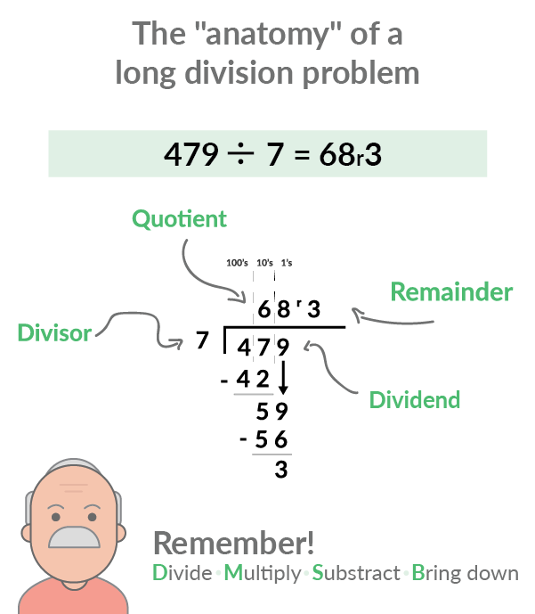

Slide 23
Integer Division: Both Integers
num1 num2
(dividend) (divisor)
7 3
3 7
143 10
14 10
1 10
num1 / num2
(quotient)
2
0
14
1
0
num1 % num2
(remainder)
1
3
3
4
1

Slide 24
Long Division
Click Here

Slide 25
Type Cast
int num1, num2;
. . .
// integer division: num1 / num2
// Double division
double result = num1 / (double)num2;
// Integer part of the double number
// You lose all decimal digits!
int intResult = (int)result;

Slide 26
Double Division: at least one double
System.out.print("Enter two integers: ");
int num1 = in.nextInt();
int num2 = in.nextInt();
// Display the double quotient
System.out.println("The double quotient is " +
(double)num1 / num2);
System.out.println("The double quotient is " +
num1 / (double) num2);

Slide 27
iClicker Question #3
int num1 = in.nextInt();
int num2 = in.nextInt();
double quotient = (double)(num1 / num2);
System.out.println("The quotient is " + quotient);
The output is ________ when the input numbers are 3 and 4.
The quotient is 0
The quotient is 0.75
The quotient is 0.0
None of the above

Slide 28
Casting Before Division
// integer division!
double quotient = (double)(num1 / num2);
// 3 / 4: 0
// quotient: 0.0
// double division!
double quotient = (double)num1 / num2;

Slide 29
Java Class Math
In package java.lang
All classes in package java.lang are imported automatically
The class provides many useful constants and methods
The constants and methods are public and static

Slide 30
Math Function round()
System.out.print("Enter a double number: ");
double dblNum = in.nextDouble();
System.out.println(Math.round(dblNum));
The output:
3 when the input is 3.49
4 when the input is 3.5
4 when the input is 3.9

Slide 31
Other Math Functions
double dblNum = in.nextDouble();
System.out.println(Math.sqrt(dblNum));
// 5.0 when input was 25
// 1.4142135623730951 when input was 2
System.out.println(Math.pow(2, 3));
// 2³ = 8.0
System.out.println(Math.pow(dblNum, 0.5));
// same as sqrt(dblNum)

Slide 32
Lesson07_Examples
Class Arithmetic

Slide 33
Constant Math.PI
double radius, area;
// Read radius from the keyboard;
area = Math.PI * radius * radius;
// Math.PI * Math.pow(radius, 2)
// Math.PI * (radius * radius)
// The result could be different
// Exchange and try it again
// to pass Codecheck tests

Slide 34
Other Operators
// Increment operator
count = count + 1;
count ++;
// Decrement operator
count = count – 1;
count --;
total = total + 5;
total += 5;
total = total – num;
total -= num;

Slide 35
Style and Syntax
// Either way is good!
count ++;
count++;
// Either way is good!
count--;
count --;
// Syntax error!
total + = 5;
// The two together “+=” is an operator
total += 5;

Slide 36
Par07_A
Circle Circumference = 2πr
Circle Area = πr²
Sphere Surface area = 4πr²
Sphere Volume = (4/3) πr³
You can use the numbers in the formulas.
They are not considered as “magic numbers”.

Slide 37
Participation Exercise Par07
Par07_A:
http://www.codecheck.it/files/2102200516abnkmmq40nc3pr7j13pm8tbbj
Par07_B:
http://www.codecheck.it/files/20062417123djm7qp3qnd2ezrisct5snstj

Slide 38
Stay in the Main room
Par06 Solutions
Breakout Rooms 1 or 2
Ask SI Leaders any questions
My Office Hours
8 – 9 pm

